Slide 1
Chapter 4: Project Integration Management
Information Technology Project Management, Eighth Edition
Note: See the text itself for full citations.

Slide 2
The Key to Overall Project Success: Good Project Integration Management
Project managers must coordinate all of the other knowledge areas throughout a project’s life cycle
Many new project managers have trouble looking at the “big picture” and want to focus on too many details
Project integration management is not the same thing as software integration
Project integration: Includes the processes and activities to identify, define, combine, unify, and coordinate the various processes and project management activities within the Project Management Process Groups.

Slide 3
What is Project Integration Management?
Main processes
Developing the project charter
Developing the project management plan
Directing and managing project work
Monitoring and controlling project work
Performing integrated change control
Closing the project or phase

Slide 4
Project Integration Management Processes
1. Developing the project charter involves working with stakeholders to create the document that formally authorizes a project—the charter.
2. Developing the project management plan involves coordinating all planning efforts to create a consistent, coherent document—the project management plan. Should be approved by relevant stakeholders
3. Directing and managing project work involves carrying out the project management plan by performing the activities included in it. (Production of Project deliverables, acquisition of additional knowledge, finish on time and within budget)
Charters are normally short and include key project information and stakeholder signatures (refer to the Canvas template)
Notes:
Includes processes and activities: to → identify, define, combine, unify, coordinate process and activities (Process , risk, 45 processes control schedule,)
Put them into 6 process

Slide 5
Project Integration Management Processes (cont’d)
4. Monitoring and controlling project work involves overseeing activities to meet the performance objectives of the project (analysis, project reports, potential changes, etc)
5. Performing integrated change control involves identifying, evaluating, and managing changes throughout the project life cycle. (require project sponsor approval)
6. Closing the project or phase involves finalizing all activities to formally close the project or phase.
Notes:
Track, review,

Slide 6
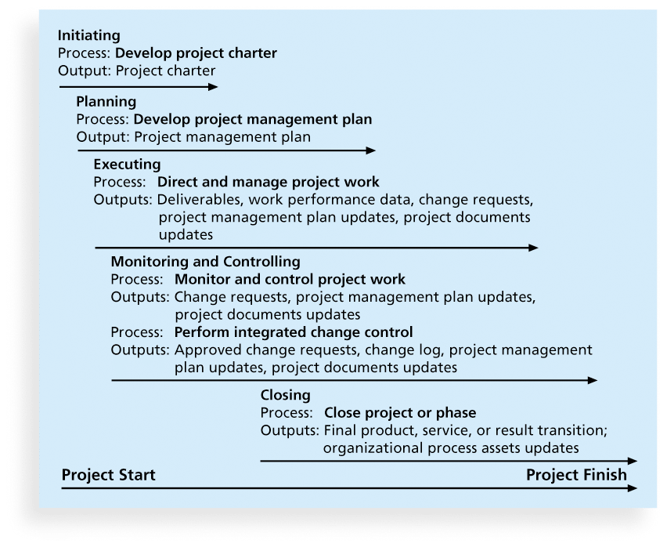
Project Integration Management Summary

Slide 7
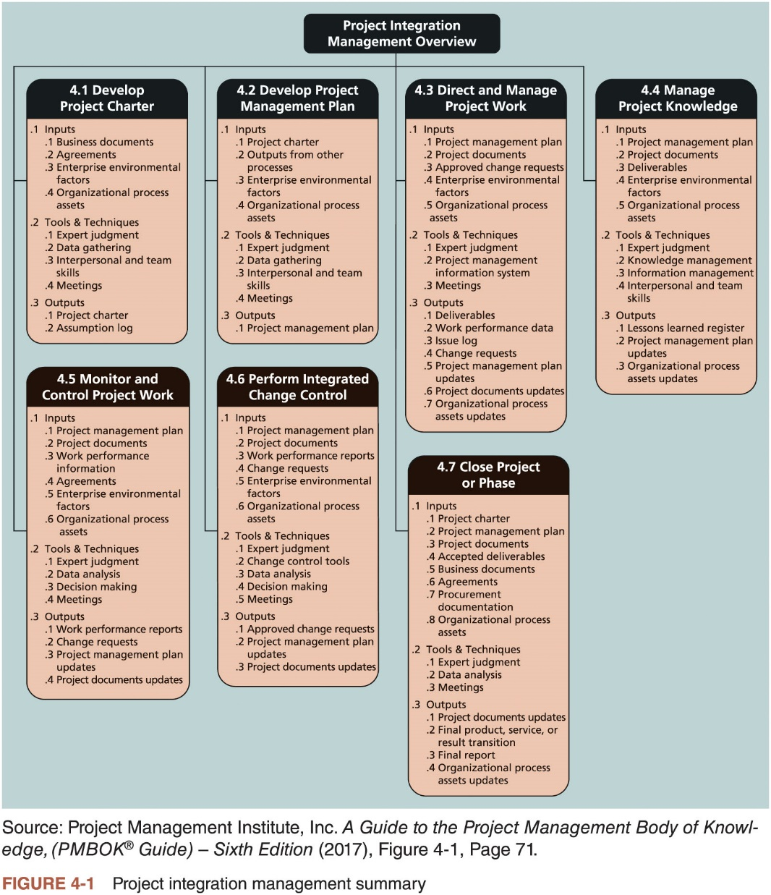
What is Project Integration Management? (3 of 3)

Slide 8
Strategic Planning and Project Selection
Strategic planning involves determining long-term objectives, predicting future trends, and projecting the need for new products and services
Organizations often perform a SWOT analysis
analyzing Strengths, Weaknesses, Opportunities, and Threats
As part of strategic planning, organizations
identify potential projects
use realistic methods to select which projects to work on
formalize project initiation by issuing a project charter

Slide 9
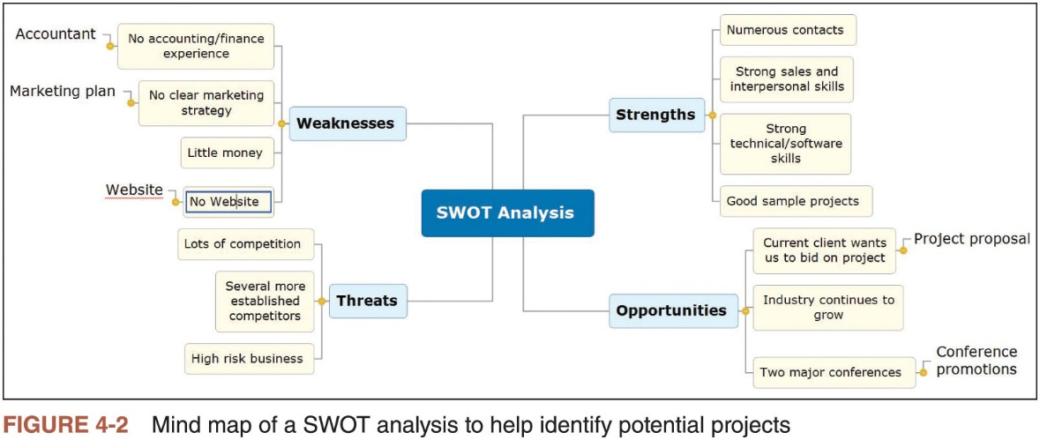
Strategic Planning and Project Selection

Slide 10
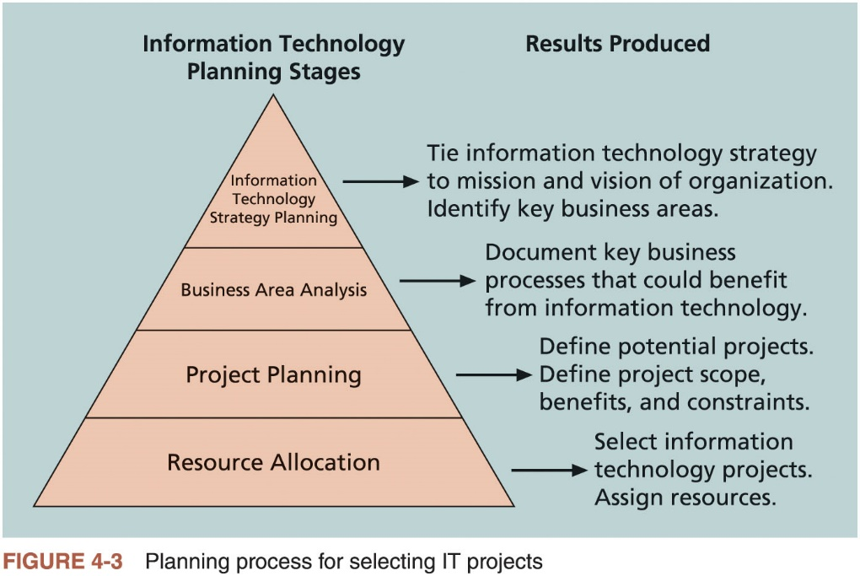
Strategic Planning and Project Selection

Slide 11
Methods for Selecting Projects
There are usually more projects than available time and resources to implement them
Methods for selecting projects include:
focusing on broad organizational needs
categorizing information technology projects
performing net present value or other financial analyses
using a weighted scoring model
implementing a balanced scorecard

Slide 12
Focusing on Broad Organizational Needs
It is often difficult to provide strong justification for many IT projects, but everyone agrees they have a high value
Projects that address broad organizational needs are much more likely to be successful because they will be important to the organization
Examples: improve safety or increase morale
Three important criteria for projects:
There is a need for the project
There are funds available
There’s a strong will to make the project succeed

Slide 13
Categorizing IT Projects
One categorization is whether the project addresses
a problem
an opportunity, or
a directive
Another categorization is how long it will take to do and when it is needed
Another is the overall priority of the project

Slide 14
Financial Analysis of Projects
Financial considerations are often an important consideration in selecting projects
Regardless of current economics
Three primary methods for determining the projected financial value of projects:
Net present value (NPV) analysis
Return on investment (ROI)
Payback analysis

Slide 15
Net Present Value Analysis
NPV: Method of calculating the expected net monetary gain or loss from a project by discounting all expected future cash inflows and outflows to the present point in time
Projects with a positive NPV should be considered if financial value is a key criterion
Projects with higher NPVs are preferred

Slide 16
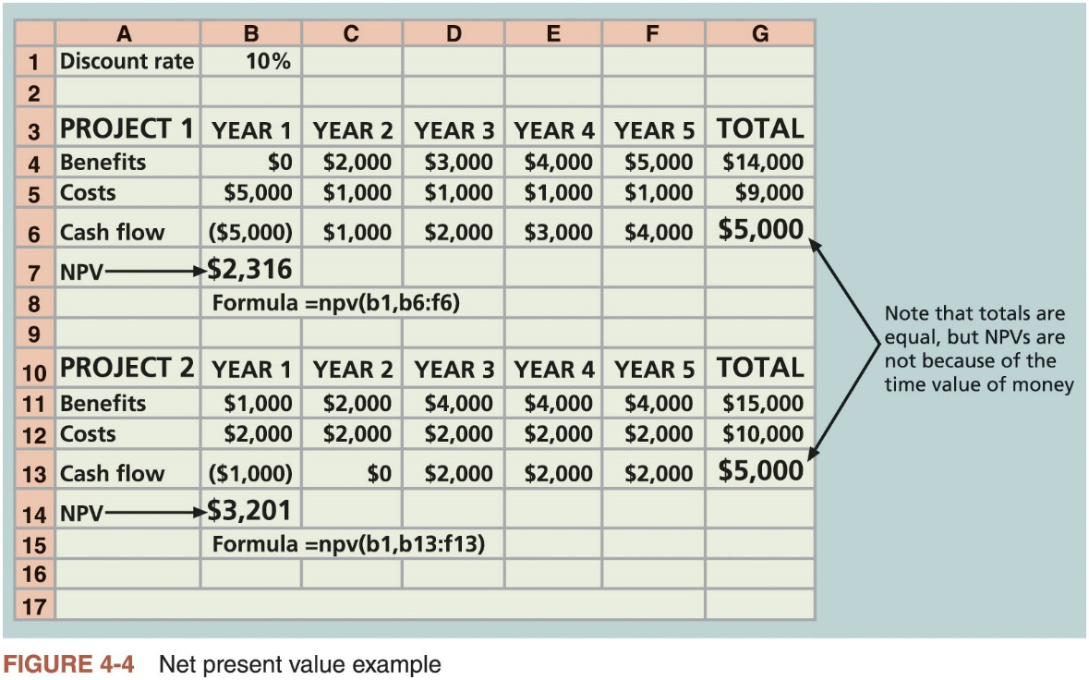
Net Present Value Analysis

Slide 17
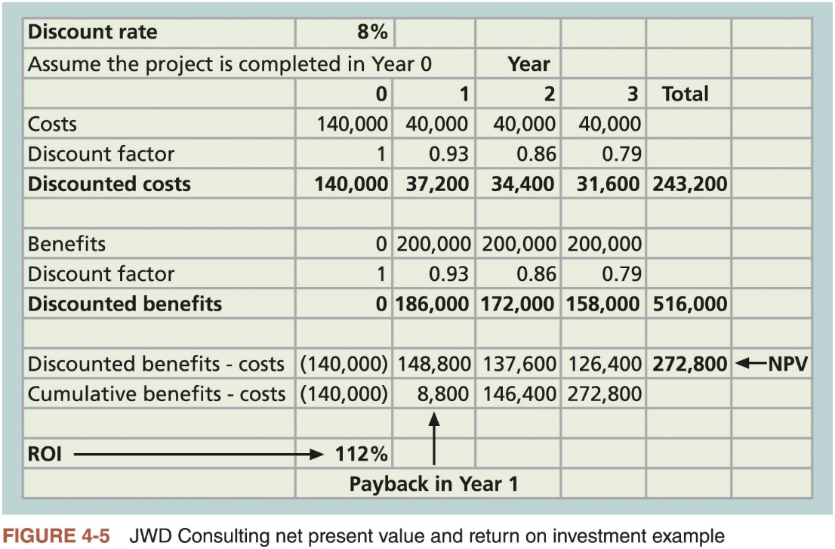
Net Present Value Analysis

Slide 18
Net Present Value Analysis
NPV calculations
Determine estimated costs and benefits for the life of the project and the products it produces
Determine the discount rate
Calculate the net present value
Important considerations
Some organizations refer to the investment year or years for project costs as Year 0 and do not discount costs in Year 0
Discount rate can vary, often based on the prime rate and other economic considerations
Costs can be entered as negative numbers and can be listed first (and then benefits)

Slide 19
How to compute NPV
https://www.youtube.com/watch?annotation_id=annotation_1418261323&feature=iv&src_vid=g4ub-xhzl10&v=N7pZZuCkFbM

Slide 20
Return on Investment
Calculated by subtracting the project costs from the benefits and then dividing by the costs
ROI = (total discounted benefits - total discounted costs) / discounted costs
The higher the ROI, the better
Many organizations have a required rate of return
Minimum acceptable rate of return on investment for projects
Internal rate of return (IRR) can by calculated by finding the discount rate that makes the NPV equal to zero

Slide 21
Payback Analysis
Another important financial consideration is payback analysis
Payback period is the amount of time it will take to recoup, in the form of net cash inflows, the total dollars invested in a project
Determines how much time will elapse before accrued benefits overtake accrued and continuing costs
Payback occurs when the net cumulative discounted benefits equals the costs
Many organizations have requirements for the length of the payback period of an investment

Slide 22
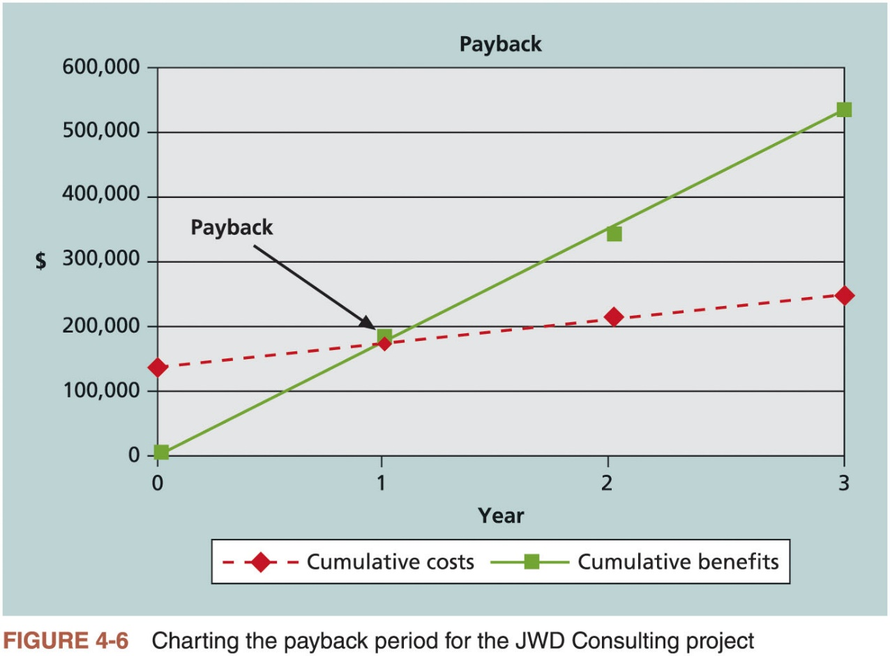
Payback Analysis (2 of 2)

Slide 23
Using a Weighted Scoring Model
Provides a systematic process for selecting projects based on many criteria
Identify criteria important to the project selection process
Assign weights (percentages) to each criterion so they add up to 100%
Assign scores to each criterion for each project
Multiply the scores by the weights and get the total weighted scores
The higher the weighted score, the better

Slide 24
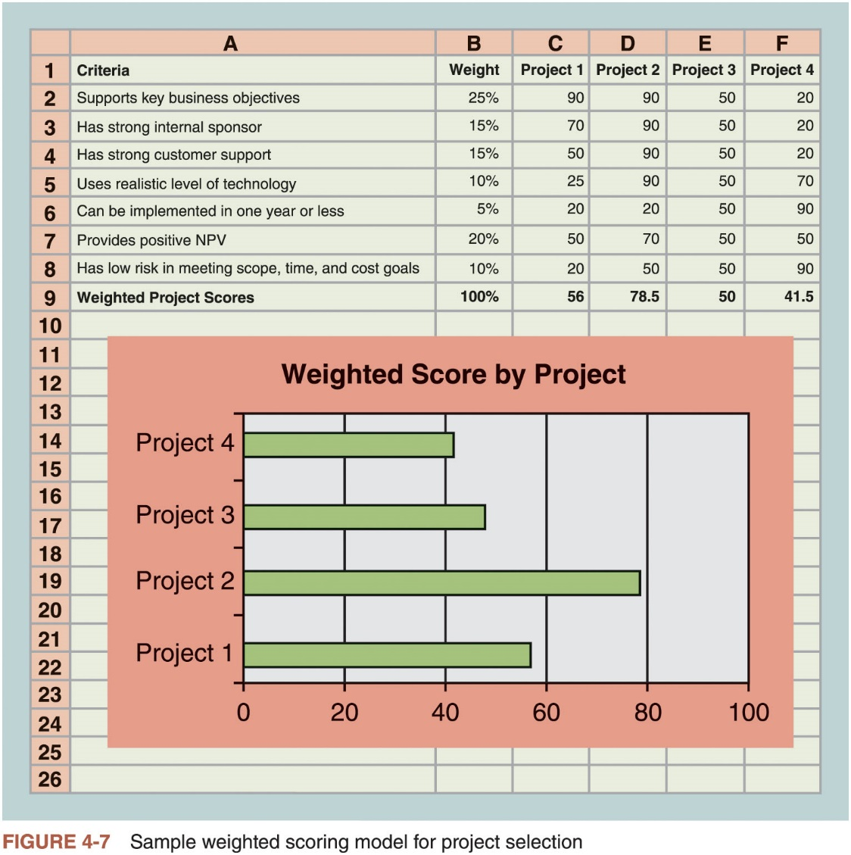
Using a Weighted Scoring Model

Slide 25
Implementing a Balanced Scorecard
Drs. Robert Kaplan and David Norton developed this approach to help select and manage projects that align with business strategy
A balanced scorecard is a strategic planning and management system that helps organizations align business activities to strategy, improve communications, and monitor performance against strategic goals
See www.balancedscorecard.org for more information

Slide 26
Developing a Project Charter
After deciding what project to work on, it is important to let the rest of the organization know
A project charter is a document that formally recognizes the existence of a project and provides direction on the project’s objectives and management
Key project stakeholders should sign a project charter to acknowledge agreement on the need and intent of the project; a signed charter is a key output of project integration management
Key project stakeholders should sign a project charter to acknowledge agreement on the need and intent of the project
A project charter is a key output of the initiation process

Slide 27
Developing a Project Charter
Inputs for developing a project charter
Business case
Benefits management plan
Agreements
Enterprise environmental factors
Organizational process assets

Slide 28
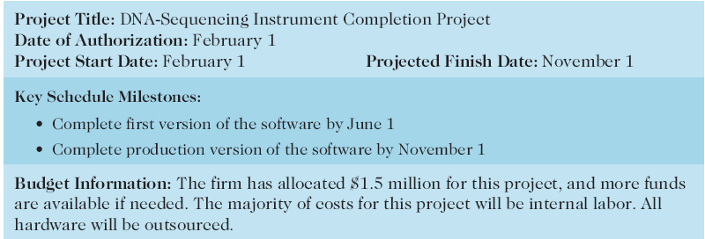
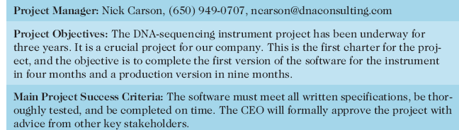
Project Charter for the DNA-Sequencing Instrument Completion Project

Slide 29
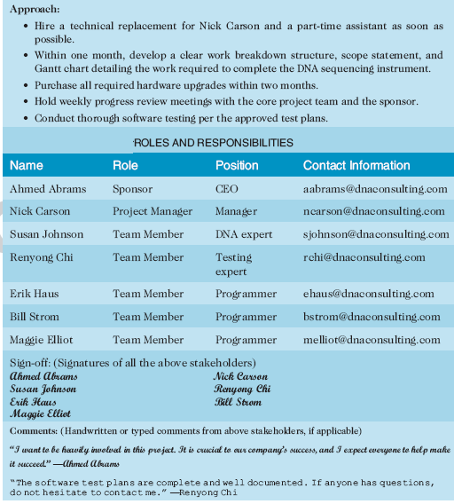
Project Charter (cont.)

Slide 30
Developing a Project Management Plan
Document used to coordinate all project planning documents and help guide a project’s execution and control
Plans created in the other knowledge areas are subsidiary parts of the overall project management plan
Common elements of a project management plan
Introduction/overview of the project
Description of how the project is organized
Management and technical processes used on the project
Work to be done
Schedule and budget information
References to other project planning documents

Slide 31
Using Guidelines to Create Project Management Plans
Major Section Headings | Section Topics
Overview | Purpose, scope, and objectives; assumptions and constraints; project deliverables; schedule and budget summary; evolution of the plan
Project Organization | External interfaces; internal structure; roles and responsibilities
Managerial Process Plan | Start-up plans (estimation, staffing, resource acquisition, and project staff training plans); work plan (work activities, schedule, resource, and budget allocation); control plan; risk management plan; closeout plan
Technical Process Plans | Process model; methods, tools, and techniques; infrastructure plan; product acceptance plan
Supporting Process Plans | Configuration management plan; verification and validation plan; documentation plan; quality assurance plan; reviews and audits; problem resolution plan; subcontractor management plan; process improvement plan
Source: IEEE Standard 1058–1998.
Table 4-3 Sample contents for the IEEE software project management plan (SPMP)

Slide 32
Directing and Managing Project Work
Involves managing and performing the work described in the project management plan
The majority of time and money is usually spent on execution
The application area of the project directly affects project execution
Products of the project are produced during the execution phase
The project manager needs to focus on leading the project team and managing stakeholder relationships to execute the project management plan successfully
Project resource management, communications management, and stakeholder management are crucial to a project’s success

Slide 33
Coordinating Planning and Execution
Project planning and execution are intertwined and inseparable activities
The main function of creating a project management plan is to guide project execution
Those who will do the work should help to plan the work
All project personnel need to develop both planning and executing skills, and they need experience in these areas

Slide 34
Providing Strong Leadership and a Supportive Culture
Project managers must lead by example
Demonstrate the importance of creating and then following good project plans and following them in project execution
Organizational culture can help project execution
Providing guidelines and templates
Tracking performance based on plans
Project managers may still need to break the rules to meet project goals
Senior managers must support those actions

Slide 35
Capitalizing on Product, Business, and Application Area Knowledge
It is often helpful for IT project managers to have prior technical experience
Small projects: the project manager may be required to perform some of the technical work or mentor team members to complete the projects
Large projects: the project manager must understand the business and application area of the project

Slide 36
Project Execution Tools and Techniques
Project managers can use specific tools and techniques to perform activities that are part of execution processes
Expert judgment
Meetings
Project management information systems

Slide 37
Project Execution Tools and Techniques
Expert judgment: Experts can help project managers and their teams make many decisions related to project execution
Meetings: Meetings allow people to develop relationships, pick up on important body language or tone of voice, and have a dialogue to help resolve problems.
Project management information systems: There are hundreds of project management software products available on the market today, and many organizations are moving toward powerful enterprise project management systems that are accessible via the Internet
See the What Went Right? example of Kuala Lumpur’s Integrated Transport Information System

Slide 38
Managing Project Knowledge
Basic types of knowledge
Explicit knowledge: easily explained using words, pictures, or numbers and is easy to communicate, store, and distribute
Tacit knowledge: difficult to express and highly personal
Knowledge management should be done before, during, and after projects are completed
Often very difficult to accomplish

Slide 39
Monitoring and Controlling Project Work
Changes are inevitable on most projects, so it’s important to develop and follow a process to monitor and control changes
Monitoring project work includes collecting, measuring, and disseminating performance information
The project management plan provides the baseline for identifying and controlling project changes
A baseline is a starting point, a measurement, or an observation that is documented so that it can be used for future comparison.

Slide 40
Media Snapshot
The 2002 Olympic Winter Games and Paralympics took five years to plan and cost more than $1.9 billion
PMI awarded the Salt Lake Organizing Committee (SLOC) the Project of the Year award for delivering world-class games
Four years before, the SLOC used a Primavera software-based system with a cascading color-coded WBS to integrate planning
Also used an Executive Roadmap, a one-page list of the top 100 Games-wide activities, to keep executives apprised of progress
Activities were tied to detailed project information within each department’s schedule
A 90-day highlighter showed which managers were accountable for each integrated activity
Fraser Bullock, SLOC Chief Operating Officer and Chief, said, “We knew when we were on and off schedule and where we had to apply additional resources. The interrelation of the functions meant they could not run in isolation—it was a smoothly running machine.”*
*Foti, Ross, “The Best Winter Olympics, Period,” PM Network (January 2004) 23

Slide 41
Performing Integrated Change Control
Main objectives
Influencing the factors that create changes to ensure that changes are beneficial
Determining that a change has occurred
Managing actual changes as they occur

Slide 42
Change Control on IT Projects
Former view: the project team should strive to do exactly what was planned on time and within budget
Problem: project teams could rarely meet original project goals
Modern view: project management is a process of constant communication and negotiation
Solution: changes are often beneficial and the project team should plan for them

Slide 43
Change Control System
Formal, documented process that describes when and how official project documents and work may be changed
Describes who is authorized to make changes, paperwork required for these changes, and any automated or manual tracking systems the project will use
Change control board (CCB) is a formal group of people responsible for approving or rejecting changes on a project
Provide guidelines for preparing change requests, evaluate change requests, and manage the implementation of approved changes
Some CCBs only meet occasionally, so it may take too long for changes to occur
Some organizations have policies in place for time-sensitive changes

Slide 44
Change Control System
Configuration management ensures that the descriptions of the project’s products are correct and complete
Involves identifying and controlling the functional and physical design characteristics of products and their support documentation
Configuration management specialists identify and document configuration requirements, control changes, record and report changes, and audit the products to verify conformance to requirements

Slide 45
Change Control System
View project management as a process of constant communication and negotiation.
Plan for change.
Establish a formal change control system, including a change control board (CCB) and IT steering committee.
Use effective configuration management.
Define procedures for making timely decisions about smaller changes.
Use written and oral performance reports to help identify and manage change.
Use project management software and other software to help manage and communicate changes.
Focus on leading the project team and meeting overall project goals and expectations.
Table 4-4 suggestions for performing integrated change control

Slide 46
Global Issues
Rapid changes in technology, such as the increased use of mobile roaming for communications, often cause governments around the world to take action
Incompatible hardware, software, and networks can make communications difficult in some regions, and a lack of competition can cause prices to soar
Organization for Economic Co-operation and Development (OECD) promotes policies that will improve the economic and social well-being of people around the world
In February 2012, the OECD called upon its members’ governments to boost competition in international mobile roaming markets
By the end of 2013, wireless broadband penetration grew to 72.4% in the OECD area

Slide 47
Closing Projects or Phases
To close a project or phase, you must finalize all activities and transfer the completed or cancelled work to the appropriate people
Main inputs are the project charter, project management plan, project documents, accepted deliverables, business documents, agreements, procurement documentation, and organizational process assets
Main tools and techniques are expert judgment, data analysis, and meetings

Slide 48
Using Software to Assist in Project Integration Management
Several types of software can be used to assist in project integration management
Documents can be created with word processing software
Presentations are created with presentation software
Tracking can be done with spreadsheets or databases
Communication software can facilitate communications
Project management software can pull everything together and show detailed and summarized information

Slide 49
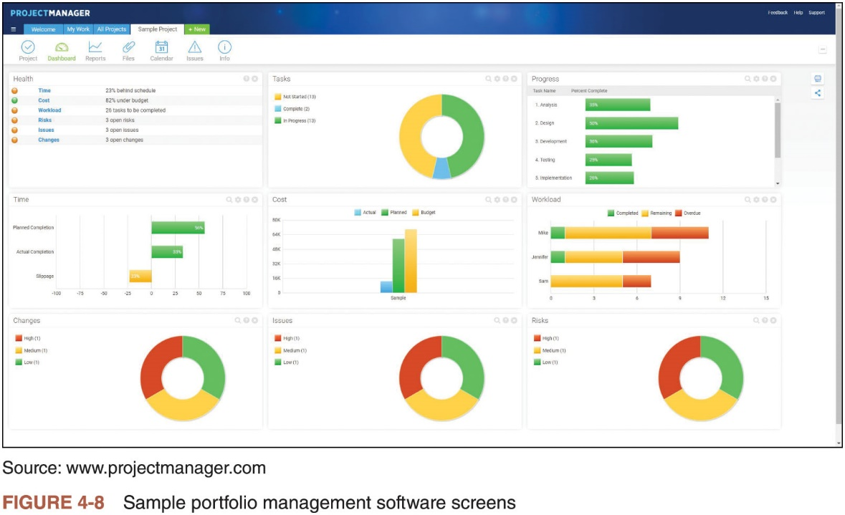
Using Software to Assist in Project Integration Management

Slide 50
Considerations for Agile/Adaptive Environments
Iterative and agile approaches promote the engagement of team members
Expectations of the project manager do not change in an adaptive environment, but control of the detailed product planning and delivery is delegated to the team
Project managers using any product life cycle should focus on creating a collaborative decision-making environment and providing opportunities for team members to develop additional skills

Slide 51
Chapter Summary
Project integration management ties together all the other areas of project management
Primary focus should be on project integration management
Main processes
Develop the project charter
Create an assumption log
Develop the project management plan
Direct and manage project execution
Manage project knowledge
Monitor and control project work
Perform integrated change control
Close the project or phase

